Slide 1
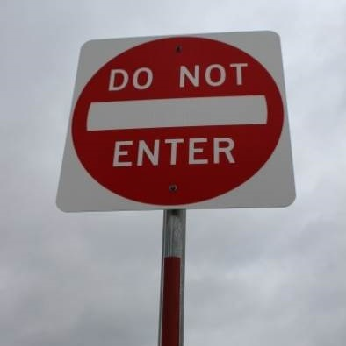
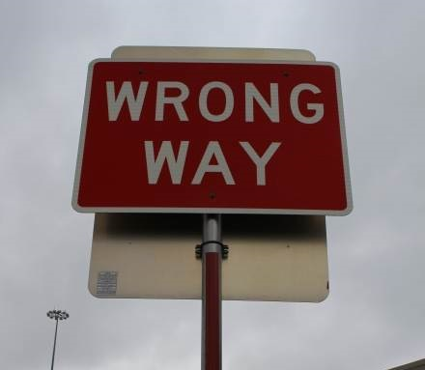
NCHRP Report 881 Traffic Control Devices and Measures for Deterring Wrong-Way Movements
Principal Investigator:
Melisa D. Finley, P.E.
Texas A&M Transportation Institute
August 2018

Slide 2
Report Authors
Melisa Finley
TTI
Raul Avelar
TTI
Steve Venglar
TTI
Gene Hawkins
Texas A&M University
Haitham Al-Deek
University of Central Florida
Notes:
Melisa Finley, P.E. of the Texas A&M Transportation Institute (TTI) will serve as the Principal Investigator (PI) for the research team. The TTI team will also include Raul Avelar, Ph.D., Gene Hawkins, Ph.D., P.E., Dominique Lord, Ph.D., Steve Venglar, P.E., and Sue Chrysler, Ph.D. The University of Central Florida (UCF) will be subcontractors to TTI on this research. The UCF team will be led by Haitham M. Al-Deek, Ph.D., P.E.

Slide 3
Project Objectives
Primary
Examine characteristics of wrong-way crashes on divided highways
Determine the impact of median width and select traffic control devices (TCDs) on their occurrence
Secondary
Determine effectiveness of emerging countermeasures implemented at freeway exit ramps
Notes:
The primary objective of National Cooperative Highway Research Program (NCHRP) 03-117 was to examine the characteristics of wrong-way crashes on divided highways and determine the impact of median width and select traffic control devices on their occurrence. A secondary objective was to identify and determine the effectiveness of emerging countermeasures implemented at freeway exit ramps.

Slide 4
Major Tasks
Reviewed and summarized previous and ongoing research efforts
Reviewed MUTCD and identified inconsistences
Analyzed multistate crash dataset
Evaluated effectiveness of emerging countermeasures
Developed proposed changes to MUTCD
Notes:
To accomplish these objectives, researchers undertook the following major efforts:
Reviewed and summarized previous wrong-way driving studies to quantify crash characteristics, identify countermeasures, and assess the effectiveness of countermeasures.
Conducted a comprehensive review of the MUTCD regarding wrong-way movement signing and markings at freeway ramps and non-signalized divided highway crossings.
Analyzed the effects of median width and traffic control devices upon wrong-way crashes on high-speed rural and urban divided highways using a multistate dataset developed under this research effort.
Evaluated the effectiveness of LEDs within the border of WRONG WAY signs and red rectangular flashing beacons above and below WRONG WAY signs at freeway exit ramps.
Developed proposed changes to the MUTCD based on the findings of the research.

Slide 5
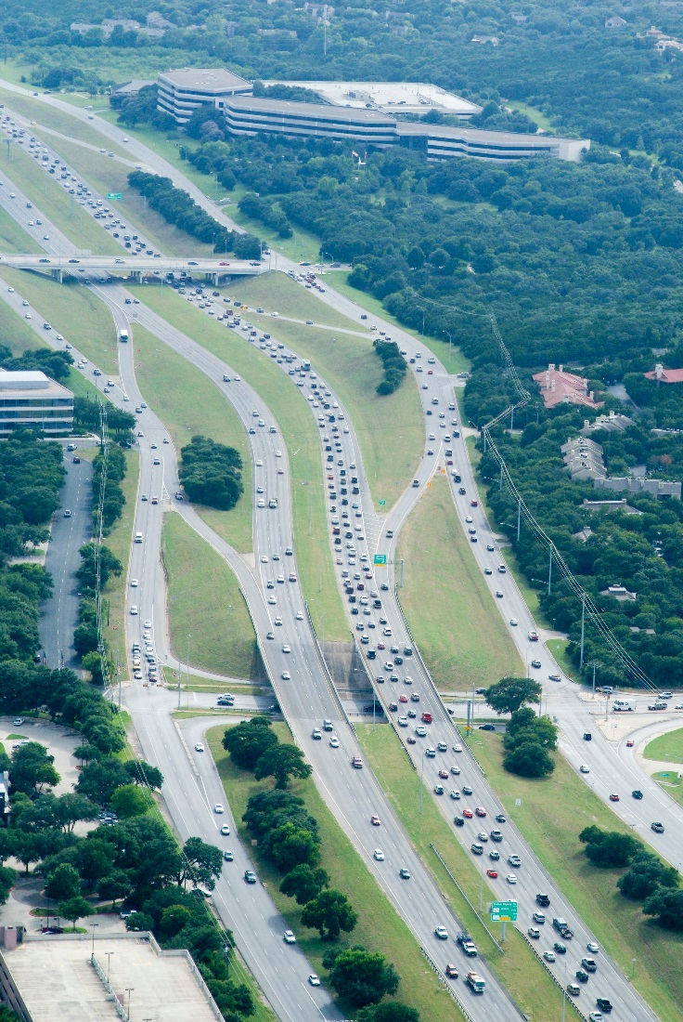
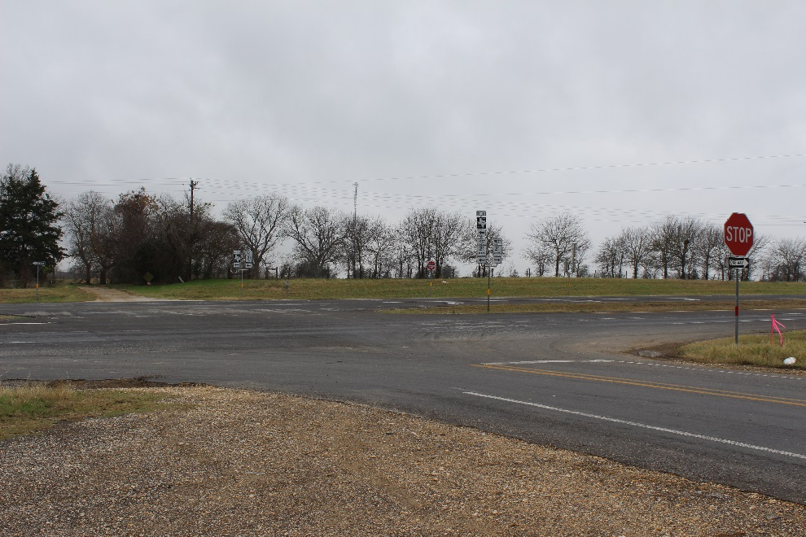
Definitions
Divided Highway
Freeway
Notes:
the term “freeway” refers to a multilane highway with fully controlled access (i.e., vehicles can only enter and exit at designated ramps).
The term “divided highway” refers to a multilane, non-freeway facility where the opposing travel directions are separated by a median. Divided highways typically have at-grade intersections and no control of access between intersections (i.e., direct driveway access allowed). Divided highways do not include roadways with continuous, two-way left-turn lanes.
In this study, the median width was defined as the area between the inside edge of the traveled way of the near travel lane or left-turn lane, if present, to the inside edge of the traveled way of the opposing through lane. This measurement included the inside shoulders, but not left-turn lanes. This definition matches the one used in the MUTCD in order to correlate interactions between the median width and traffic control devices. The medians were either raised (i.e., curb) or depressed (i.e., landscape).

Slide 6
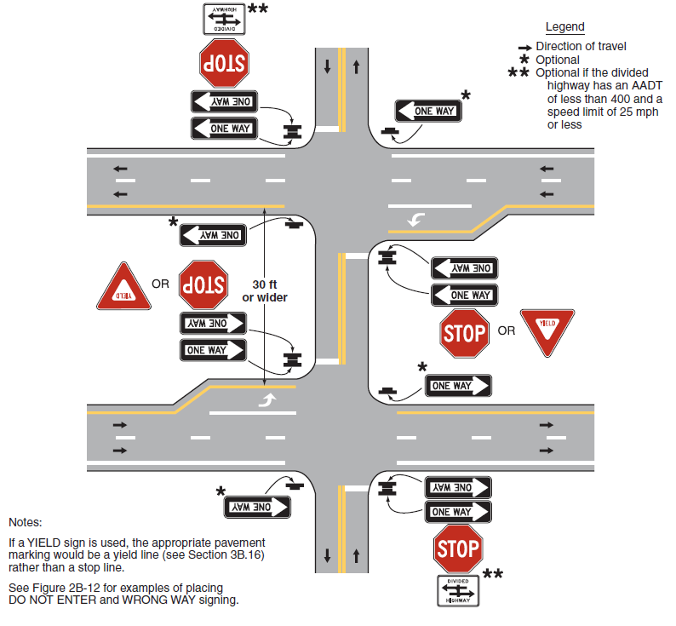
Definitions
Median Width
Notes:
In this study, the median width was defined as the area between the inside edge of the traveled way of the near travel lane or left-turn lane, if present, to the inside edge of the traveled way of the opposing through lane. This measurement included the inside shoulders, but not left-turn lanes. This definition matches the one used in the MUTCD in order to correlate interactions between the median width and traffic control devices. The medians were either raised (i.e., curb) or depressed (i.e., landscape).

Slide 7
2009 MUTCD Review Findings
Lack of consistent median width definition
Some question appropriateness of 30-ft threshold median width
Ambiguity surrounding side of road for DO NOT ENTER and WRONG WAY signs
Figure 2B-12 only for median widths ≥ 30 ft and does not indicate required versus optional
Several inconsistencies between text and figures
Notes:
Lack of a consistent median width definition between the MUTCD and Green Book.
Appropriateness of the 30-ft threshold median width to determine whether a crossing at a divided highway is considered a single intersection or two separate intersections.
Ambiguity surrounding the side of the road for required and optional signs.

Slide 8
High-Speed (≥ 50 mph), Divided Highway Safety Analysis
Multistate crash dataset
Probability analysis using logistic regression
4 safety models developed
Type of Corridor | Texas | Florida | California | Overall
Crash - Urban - Rural | 168 57 111 | 142 94 48 | 48 21 27 | 358 172 186
Control - Urban - Rural | 122 57 65 | 137 93 44 | 49 42 7 | 308 157 151
Notes:
In order to assess the characteristics of wrong-way crashes on divided highways and determine the effects of multiple design features and traffic control devices upon wrong-way crashes on divided highways, the research team compiled a multistate crash dataset using data from Texas, Florida, and California (HSIS). These three states provided geographic representation from the western, central, and eastern United States.
In order to avoid biasing the results by just focusing on sites with a reported history of wrong-way crashes, the research team wanted to supplement the dataset with data from sites with no recorded wrong-way crashes. In order to achieve this goal, the research team developed a procedure to draw statistically representative site samples from the three states under study.
The final method of analysis defined the response variable as the probability of wrong-way crashes. The data allowed estimating such probability via the indicator variable “crash,” which equaled 1 if a data point represented an instance of wrong-way crash and equaled 0 if a data point represented a site with no recorded wrong-way crash (i.e., control corridors). Therefore, for a given set of conditions (e.g., traffic volume, median width, etc.), the average of the variable “crash” represented an estimate of the probability of a wrong-way crash. A logistic regression approach allowed researchers to model the relationships with potential explanatory variables as changes in the odds of a wrong-way crash occurring.
4 models = rural, urban, rural night, and urban night

Slide 9
Median Width at Wrong-Way Entry Points with Median Openings
Notes:
Based on a review of the crash diagrams, crash descriptors (e.g., vehicle direction and side of the roadway), and engineering judgment, the research team identified the most likely wrong-way entry point in each crash corridor in each state. More than two-thirds of the wrong-way entries from intersecting roadways occurred where median openings were present. These wrong-way entries at median openings resulted in 75 percent of the wrong-way crashes that occurred on high-speed divided highways with four lanes (two in each direction) and a grass median.

Slide 10
Type of Control in Median Opening at Wrong-Way Entry Points
Notes:
According to the MUTCD, for median widths less than 30 ft, no control is needed on the interior approaches in the median. For median widths 30 ft or wider, the interior approaches in the median should be controlled with a STOP or YIELD sign. For wrong-way entries at intersections with median openings, researchers found that 18 percent of the sites had median widths less than 30 ft and 82 percent of the sites had median widths 30 ft or wider.
Figure 3 shows the type of control in the median opening (i.e., none, STOP sign, or YIELD sign) at the presumed wrong-way entry points by median width. No control was found at 110 (40 percent) of the wrong-way entry points with median widths that ranged from 3 to 241 ft. Seventy-two percent of the locations without control had median widths greater than 30 ft (denoted by line). All but three of these locations had median widths from 30 to 80 ft wide. The research team did verify with Google Earth that the larger median width values did not have any control in the median opening.
STOP or YIELD signs were found in the median opening at 47 (17 percent) and 117 (43 percent) of the wrong-way entry points, respectively. Twelve percent of these locations had median widths less than 30 ft.
Only 17 corridors had medians wider than 120 ft, and the majority of these sites had STOP signs in the median opening. In contrast, for median widths 120 ft or less, all three types of control in the median opening were represented (i.e., no control, STOP sign, and YIELD sign). Researchers reviewed the impact of removing median widths larger than 120 ft on the modeling process and found no undue influence in the model parameter estimates. Therefore, researchers restricted the range for statistical analysis to sites with median widths less than or equal to 120 ft.

Slide 11
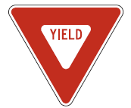
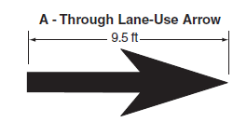
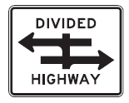
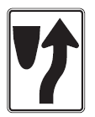
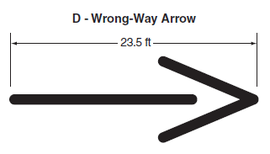
TCDs of Interest
Notes:
Below is a preliminary list of the variables of interest.
Area type (urban or rural).
Speed limit (≥ 50 mph or ≤ 45 mph).
Annual average daily traffic.
Average distance to the opposing through traffic lanes (includes outside shoulder and main lanes of near major roadway, auxiliary lanes in both directions, and the median width).
Number of driveways in corridor.
Number of unsignalized intersections in corridor.
Distance to closet intersection.
Distance to closet driveway.
Unsignalized intersections in corridor treated as one or two intersections (1 or 2).
Corridor length.
Dependent upon the sample size, some of these variables may need to be combined (e.g., the number of intersections and driveways per mile) or categorized into groups (e.g., less than 5, 5 to 10, etc.). Other variables will be considered as needed. Even if all the variables in the preliminary list are potentially important, sample size, range and distribution of variables, and correlations among pairs of variables are all limiting factors that would potentially impede this research from including all of the variables in the analysis. With the intent of avoiding modelling pitfalls (e.g., overfitting, multicollinearity etc.) the research team will carefully evaluate various combinations of variables such that the most appropriate model is selected.

Slide 12
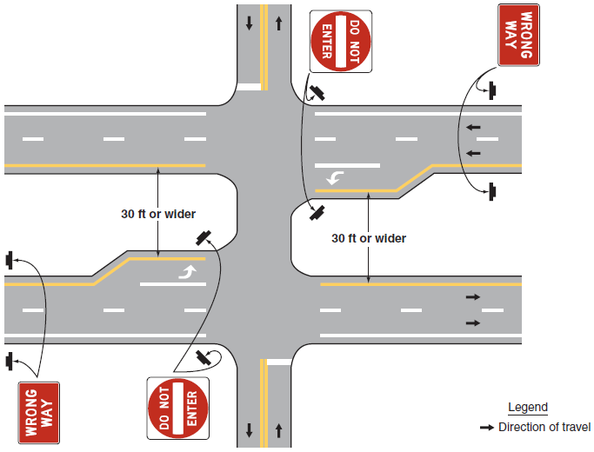
Variables Related to Reduction in Risk of Wrong-Way Crashes
DO NOT ENTER and WRONG WAY signs on outside of wrong-way maneuver
Wrong-way arrow markings on the divided highway through lanes
Centerline in median opening
Use of stop or yield lines in median opening when interior control provided

Slide 13
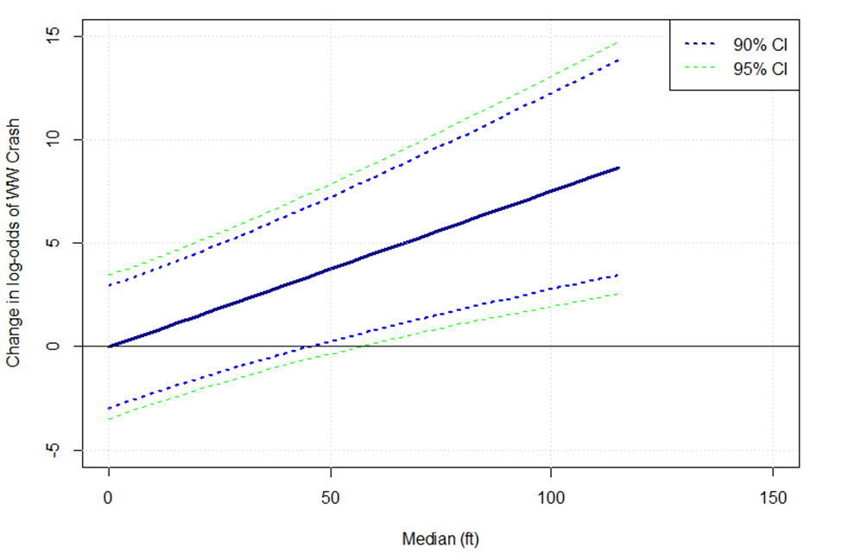
Crash Correlation to Median Width
Dependent upon presence of control in median opening
STOP or YIELD sign = no change in crash risk
Without control = odds of crash increased by multiplicative factor for every additional 10 ft of median width
Criterion may be 50 ft instead of 30 ft
Notes:
The correlation between wrong-way crashes and the median width was found to be dependent upon the presence of control in the median opening in all four models. At sites with a STOP or YIELD sign, there was no change in the risk of wrong-way crashes based on the median width (i.e., statistically equivalent to zero). Conversely, at sites without a STOP or YIELD signs, it was found that the odds of wrong-way crashes tended to increase by a multiplicative factor for every additional 10 ft of median width.
The research team used the rural dataset to investigate if a minimal threshold for recommending when median opening control (i.e., STOP or YIELD sign) should be used could be determined. Researchers selected the rural model instead of the urban model because of the wider range of median widths without control in the median opening in the rural dataset. Researchers compared the magnitude of the effect of median width to the amount of unexplained variability of differences between sites, after accounting for the effects of other variables. The rationale was that although this analysis found an increasing effect for increasing median widths, such an effect may not be practically significant when considering the random variability in the odds of wrong-way crashes from site to site. If the variability was large compared to the change in odds linked to median width, such an expected change should be virtually undetectable. However, it was also anticipated that for a wide enough median, the expected increase in odds of wrong-way crashes associated with median width should be clearly observable, even when the random variation in the odds of wrong-way crashes due to differences between sites was present.
This figure shows the log-odds line of the effect of median width (compared to median width equal to 0 ft) and the 90 percent and 95 percent confidence envelope of uncertainty associated with variability between sites (i.e., the model random effect variance). It can be seen that, depending on the level of confidence desired, the increase in wrong-way crash log-odds associated with median width should be clearly identifiable for median widths of about 50 ft and wider.

Slide 14
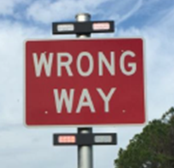
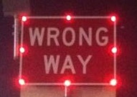
Emerging TCDs
LED border-illuminated WRONG WAY signs
Wrong-way event data from Texas and Florida
Texas = 32 percent reduction*
Florida = 19 percent reduction
Red rectangular flashing beacons
Florida detection data only
23 detections over 527 days
17 (74%) confirmed or probably turn arounds
Need more sites and data
*Statistically significant at a 5 percent significance level
Notes:
In terms of the expected change in events, the Texas EMF indicates a 32 percent reduction in the WWD events on the US 281 test corridor after the installation of WRONG WAY signs with flashing red LEDs around the border at all exit ramps in the corridor. In other words, the WWD events at the exit ramps with the border-illuminated WRONG WAY signs were reduced by about one-third. This percent change was statistically significant at a 5 percent significance level (α=0.05), and the 95 percent confidence interval was −55 percent to −9 percent. In 2014, Finley et al. (2014) found similar results = 38 percent reduction.
In terms of the expected change in events, the Florida EMF indicates a 19 percent reduction in the WWD events at the treatment sites after the installation of WRONG WAY signs with flashing red LEDs around the border. However, since the confidence interval includes 1.0, it cannot be stated with 95 percent confidence that the treatment had an effect.
The research team evaluated the effectiveness of red RFBs above and below WRONG WAY signs at freeway ramps using WWD detection data from the Central Florida Expressway Authority (CFX) in Florida. Red RFBs were implemented at five initial ramps starting in February 2015. The limited number of sites (five) and recent implementation (2015) made it difficult to analyze the effectiveness of these devices using 911 calls, citations, and crash data. Therefore, researchers were able to perform only a preliminary analysis on the WWD detections captured by these devices. A detailed statistical analysis can be conducted once enough data are collected from these and additional implementation sites.
Based on the available dataset, it appears that at least three-quarters of the WWD detections resulted in the errant driver self-correcting before reaching the main lanes. These promising findings led CFX to install red RFBs at 30 other ramps in 2016 and 2017, resulting in a total of 35 ramps equipped with red RFB WRONG WAY signs. These additional ramps will provide more data that can be used in future analysis.

Slide 15
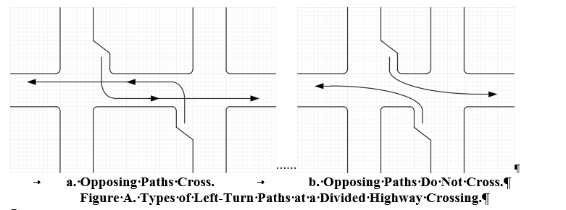
Recommended Changes to MUTCD Section 1A.13 Definitions
Intersection definition
Notes:
The research indicates that the 30-ft threshold criterion may not be appropriate for distinguishing between one or two intersections. However, the focus of this research effort was on wrong-way movements, and there are many other factors that impact the function of a divided highway crossing as one intersection or two.
Whether a divided highway functions as one or two intersections is determined by whether there is right-of-way control on the interior approaches. Interior right-of-way control is appropriate when two conditions are present: (1) the paths of opposing left turns from the divided roadway cross one another, and (2) there is adequate storage on the interior approach for a vehicle to stop at the stop/yield line. If the opposing left-turn paths from the divided highway do not cross or there is not adequate storage in the interior, then the divided highway crossing functions as a single intersection. Thus, the key to intersection right-of-way control is based on left-turn paths and interior storage.

Slide 16
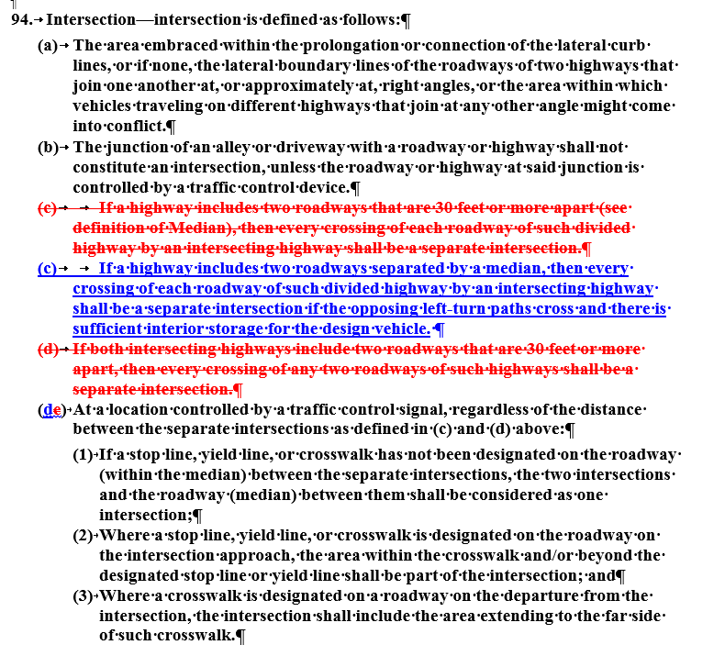
Notes:
Researchers have revised the definition of intersection in element (c) to represent this. The revision eliminates the 30-ft criterion and allows the engineer to determine the intended function of a divided highway crossing.
Replacing the existing paragraph (c) in the definition for an intersection with a new paragraph (c) eliminates the need for paragraph (d) in the definition. The new paragraph (c) deletes the reference to the 30-ft separation distance.

Slide 17
Recommended Changes to MUTCD Section 1A.13 Definitions
Intersection definition
Median definition
Notes:
The definitions in early editions of the MUTCD duplicated those in the Uniform Vehicle Code (UVC).
No edition of the UVC (including the three most recent editions: 1987, 1992, and 2000) contain a definition for the term median.
The 1971 edition included a list of terms and definitions.
The 1978 and the 1988 editions of the MUTCD removed the terms and definitions since the terms had the definitions as presented in the UVC or the American Association of State Highway and Transportation Officials (AASHTO) highway definitions.
The written definition for median first appeared in the MUTCD in the 2000 edition. The chair of the National Committee on Uniform Traffic Control Devices (NCUTCD) Edit Committee during the time the 2000 MUTCD was being prepared verbally indicated that the definition for median was developed by the committee based on judgment. As such, there is no documentation to support the creation of this definition.
The measurement of the median width was first illustrated in the MUTCD in the 2003 edition.
The current MUTCD definition for median width conflicts with the definition used in the AASHTO Green Book. The AASHTO Green Book definition preceded the MUTCD definition. The AASHTO definition was used as the basis in prior National Cooperative Highway Research Program research on median intersection design (Harwood et al. 1995).
Researchers recommend changing the definition and deleting how the median width is measured. Once the 30-ft criterion is removed (see above), the portion of the definition related to measuring width becomes unnecessary. Researchers reviewed the MUTCD for sections that reference median width and recommend changes where needed to accommodate the deletion of this definition.
Researchers considered including the sentence “The median width defines the available storage distance for the interior of a divided highway” but decided not to include this sentence because it is overly restrictive and the actual storage distance could be as wide as the AASHTO median width definition, although such storage would prevent left turns from the divided highway.

Slide 18
Recommended Changes to MUTCD Section 2A.23
Notes:
The existing guidance language has been deleted due to the changes in the definition for intersection and median to eliminate the use of the 30-ft criterion for defining divided highway crossings as one or two intersections.
There are numerous factors that establish the divided highway crossing as one or two intersections. Khazraee and Hawkins (2015, 2016) developed figures for guiding the decision for a limited number of conditions. Due to the number of factors that can impact the function of a divided highway crossing, it is not appropriate to add these figures to the MUTCD.
This section has been revised to recommend treating the crossing as separate intersections when two conditions exist: left-turn paths cross, and there is adequate storage for the design vehicle.
Support language is also provided to indicate a general range for a median where it may be possible for the crossing to function as one or two intersections depending upon the site-specific conditions.

Slide 19
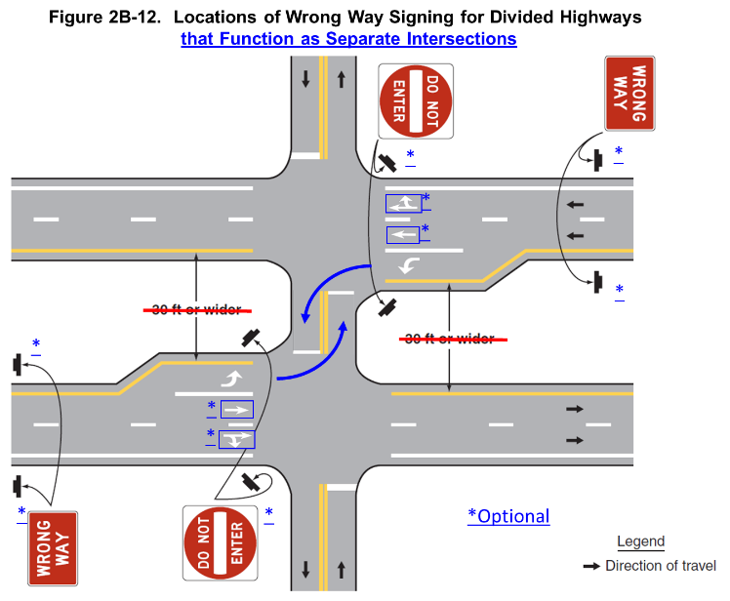
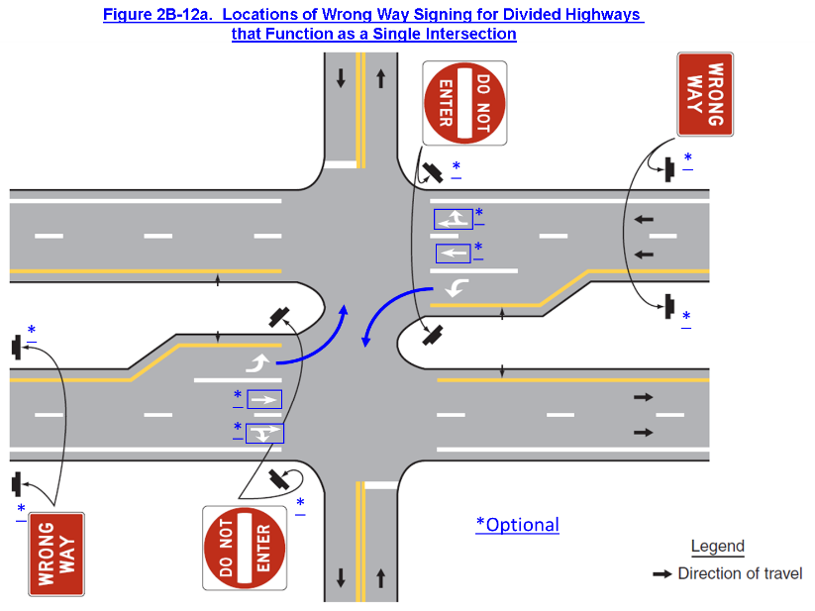
Recommended Changes to MUTCD Section 2B.37 DO NOT ENTER Sign
Revised P01, P02, and P05
Figure 2B-12
Added asterisks to indicate optional signs
Added left-turn paths
Added lane-use arrows
Created new Figure 2B-12a
Allowed use of red LEDs
Notes:
Paragraph 1 has been revised to incorporate changes approved by the NCUTCD in June 2013. Additional changes were made to this paragraph to make it consistent with the research recommendations for MUTCD changes.
Researchers have revised the language in Paragraphs 2 and 5 to clarify that the recommended sign is the one placed on the right-hand side of a driver traveling on the wrong direction. The sign on the left side of the wrong-way driver is optional.
Researchers have added asterisks to Figure 2B-12 to indicate the optional installation of the DO NOT ENTER sign, added the left-turn paths, added lane-use arrows (see Section 3B-20), and revised the figure title.
Researchers have added a new Figure 2B-12a to address DO NOT ENTER signs at a single-intersection divided highway crossing. Left-turn paths do not cross in this new figure.
Paragraph 05a, approved by the NCUTCD in June 2014, has been added. This allows the use of red light-emitting diodes (LEDs) in the DO NOT ENTER sign.

Slide 20
Recommended Changes to MUTCD Section 2B.38 WRONG WAY Sign
Same side of the road as DO NOT ENTER (P02a)
Allowed use of red LEDs
Figure 2B-12
Added asterisks to indicate optional signs
Created new Figure 2B-12a
Notes:
Guidance has been added as Paragraph 02a to indicate that the sign should be on the same side of the road as the DO NOT ENTER sign.
Paragraph 03a, approved by the NCUTCD in June 2014, has been added. This allows the use of red LEDs in the WRONG WAY sign.
Asterisks have been added to Figure 2B-12 to indicate the optional installation of the WRONG WAY signs.
Researchers have added a new Figure 2B-12a to address WRONG WAY signs at a single-intersection divided highway crossing. Left-turn paths do not cross in this new figure.

Slide 21
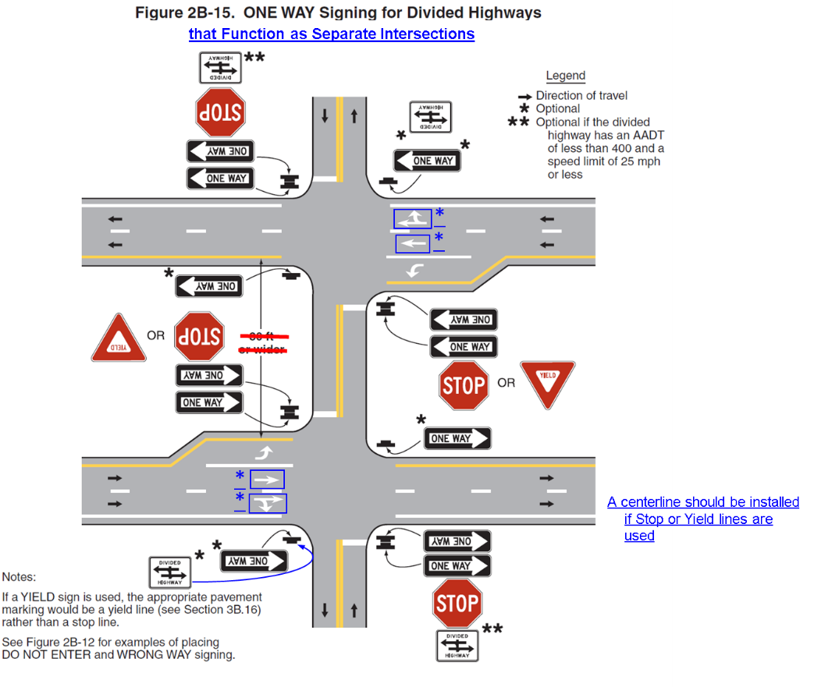
Recommended Changes to MUTCD Section 2B.40 ONE WAY Signs
Revised P03, P04, and P05
Revised Figure 2B-15
Notes:
The language in Paragraphs 3, 4, and 5 has been revised to reflect the function of the crossing as one or two intersections rather than on the median width. The revised language in Paragraph 5 allows for the use of the optional far right ONE WAY sign at any divided highway intersection, regardless of median width/intersection function, to be consistent with how it is shown in Figure 2B-15.
Figure 2B-15 has been revised to make it applicable to two separate intersections. Optional lane-use arrows (see Section 3B.20) and a second divided highway sign have been added. A note regarding the centerline in the median opening has also been added.
Figure 2B-16 has been revised to make it applicable to a single intersection. The notes have been revised to indicate that the far right ONE WAY sign is optional even if only the other ONE WAY signs are used. The notes referencing other figures have also been revised. The reference to the median width distance has been removed. Optional lane-use arrows have been added (see Section 3B.20).
The researchers recommend deletion of Figure 2B-17. With the elimination of the method of showing how to measure median width, this figure is the same as Figure 2B-16 except for the geometrics of the divided highway left-turn lanes. The traffic control devices shown in the two figures are the same.
An option has been added as Paragraph 06a to allow the installation of ONE WAY signs at only one corner of the intersection of ramps and a crossroad. The language in Section 2B.41 where ONE WAY signs are required at only one corner conflicts with the language in 2B.40 where ONE WAY signs are required on the near right and far left corners.

Slide 22
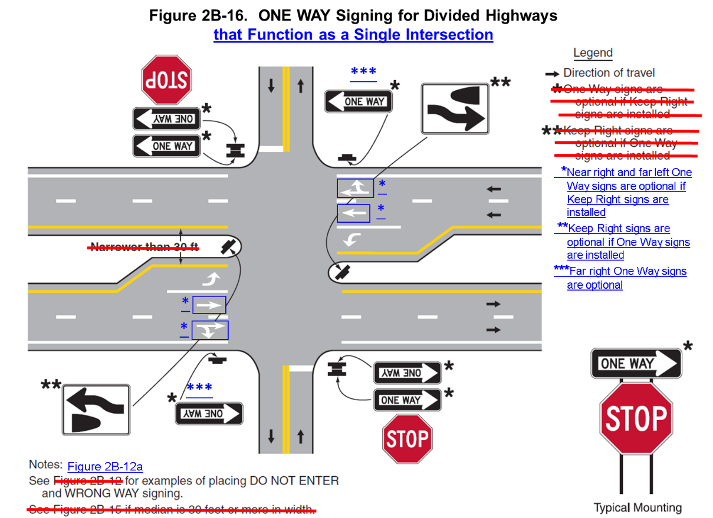
Recommended Changes to MUTCD Section 2B.40 ONE WAY Signs
Revised P03, P04, and P05
Revised Figure 2B-15
Revised Figure 2B-16
Notes:
The language in Paragraphs 3, 4, and 5 has been revised to reflect the function of the crossing as one or two intersections rather than on the median width. The revised language in Paragraph 5 allows for the use of the optional far right ONE WAY sign at any divided highway intersection, regardless of median width/intersection function, to be consistent with how it is shown in Figure 2B-15.
Figure 2B-15 has been revised to make it applicable to two separate intersections. Optional lane-use arrows (see Section 3B.20) and a second divided highway sign have been added. A note regarding the centerline in the median opening has also been added.
Figure 2B-16 has been revised to make it applicable to a single intersection. The notes have been revised to indicate that the far right ONE WAY sign is optional even if only the other ONE WAY signs are used. The notes referencing other figures have also been revised. The reference to the median width distance has been removed. Optional lane-use arrows have been added (see Section 3B.20).
The researchers recommend deletion of Figure 2B-17. With the elimination of the method of showing how to measure median width, this figure is the same as Figure 2B-16 except for the geometrics of the divided highway left-turn lanes. The traffic control devices shown in the two figures are the same.
An option has been added as Paragraph 06a to allow the installation of ONE WAY signs at only one corner of the intersection of ramps and a crossroad. The language in Section 2B.41 where ONE WAY signs are required at only one corner conflicts with the language in 2B.40 where ONE WAY signs are required on the near right and far left corners.

Slide 23
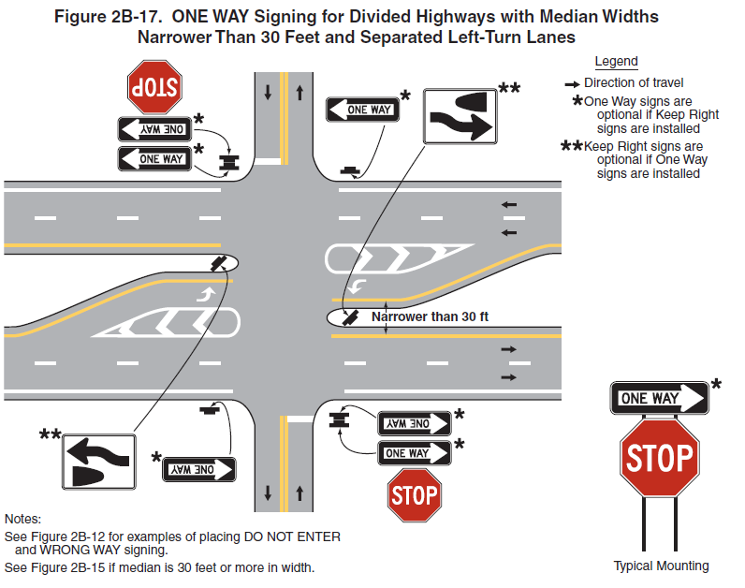
Recommended Changes to MUTCD Section 2B.40 ONE WAY Signs
Revised P03, P04, and P05
Revised Figure 2B-15
Revised Figure 2B-16
Deletion of Figure 2B-17
Notes:
The language in Paragraphs 3, 4, and 5 has been revised to reflect the function of the crossing as one or two intersections rather than on the median width. The revised language in Paragraph 5 allows for the use of the optional far right ONE WAY sign at any divided highway intersection, regardless of median width/intersection function, to be consistent with how it is shown in Figure 2B-15.
Figure 2B-15 has been revised to make it applicable to two separate intersections. Optional lane-use arrows (see Section 3B.20) and a second divided highway sign have been added. A note regarding the centerline in the median opening has also been added.
Figure 2B-16 has been revised to make it applicable to a single intersection. The notes have been revised to indicate that the far right ONE WAY sign is optional even if only the other ONE WAY signs are used. The notes referencing other figures have also been revised. The reference to the median width distance has been removed. Optional lane-use arrows have been added (see Section 3B.20).
The researchers recommend deletion of Figure 2B-17. With the elimination of the method of showing how to measure median width, this figure is the same as Figure 2B-16 except for the geometrics of the divided highway left-turn lanes. The traffic control devices shown in the two figures are the same.
An option has been added as Paragraph 06a to allow the installation of ONE WAY signs at only one corner of the intersection of ramps and a crossroad. The language in Section 2B.41 where ONE WAY signs are required at only one corner conflicts with the language in 2B.40 where ONE WAY signs are required on the near right and far left corners.

Slide 24
Recommended Changes to MUTCD Section 2B.40a
New section for wrong-way traffic control at divided highway crossings
Some language duplicated from other sections
Similar to 2B.41 for interchange ramps
Notes:
This is a new section that has been added to address the use of traffic control devices as a system to deter wrong-way movement at a divided highway intersection. Some of the language in this new section duplicates language in other sections (such as the rotation of the KEEP RIGHT sign). If this new section is added to the MUTCD, the researchers recommend deleting the duplicated language from the other sections.
One of the challenges of adding this section is that it addresses the use of both signs and markings, even though the section is in Part 2. However, since Section 2B.41 also addresses pavement markings, the researchers felt comfortable addressing markings in this section.

Slide 25
Recommended Changes to MUTCD Section 3B.20
Option added to allow use of lane-use arrows on divided highway to deter wrong-way movements (P22a)
Option added to allow wrong-way arrow markings to be used in lieu of or in addition to lane-use arrows (P37a)
Notes:
Section 3B.20—Pavement Word, Symbol, and Arrow Markings
An option has been added as Paragraph 22a to specifically allow the use of lane-use arrows on the divided highway to deter wrong-way movement.
The researchers have deleted the reference to Figure 2B-17 in Paragraph 23 since they are recommending this figure be deleted. The figure could be moved to Section 3B.20 as an example of the use of lane-use arrows in offset left-turn lanes if desired.
An option has been added as Paragraph 37a to allow the wrong-way arrow markings to be used in lieu of or in addition to lane-use arrows.

Slide 26
Other Recommended Changes to MUTCD
Section 2B.32 KEEP RIGHT and KEEP LEFT Signs
Section 2B.41 Wrong-Way Traffic Control at Interchange Ramps
Section 2B.42 Divided Highway Crossing Signs
Section 2B.09 YIELD Sign Applications
Section 4C.01 Studies and Factors for Justifying Traffic Control Signals

Slide 27
For More Information
Final Report available at:
http://www.trb.org/Main/Blurbs/178000.aspx
Contact the Principal Investigator:
Melisa D. Finley, P.E. Texas A&M Transportation Institute 979-845-7596 m-finley@tti.tamu.edu

